Slide 1

Virtual Reality Nuclear Reactor Simulator
Reinventing Nuclear Education

Slide 2
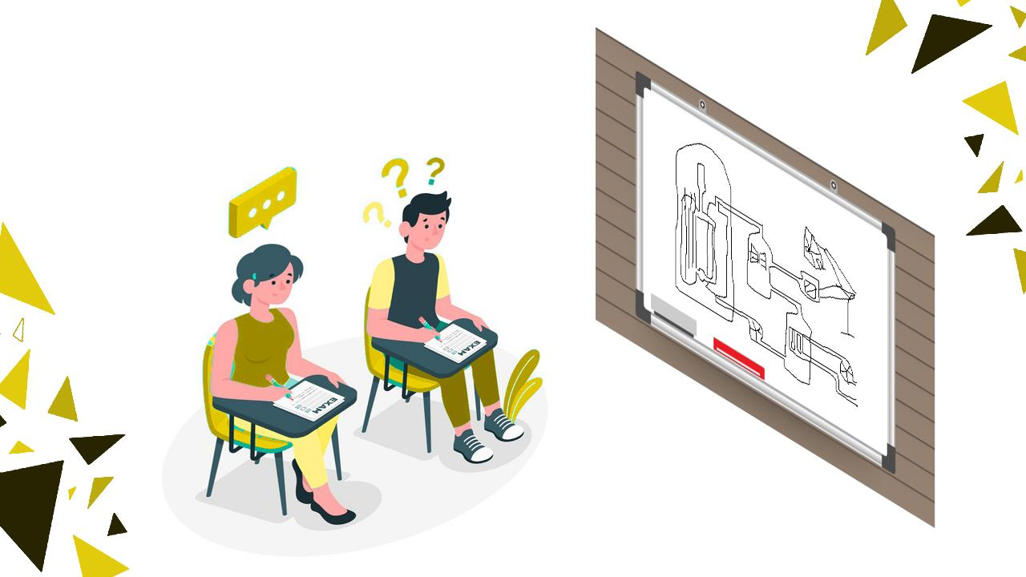
The Problem

Slide 3
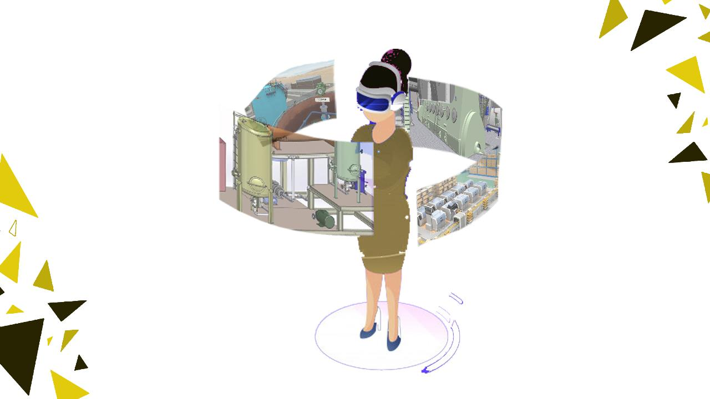
The solution

Slide 4

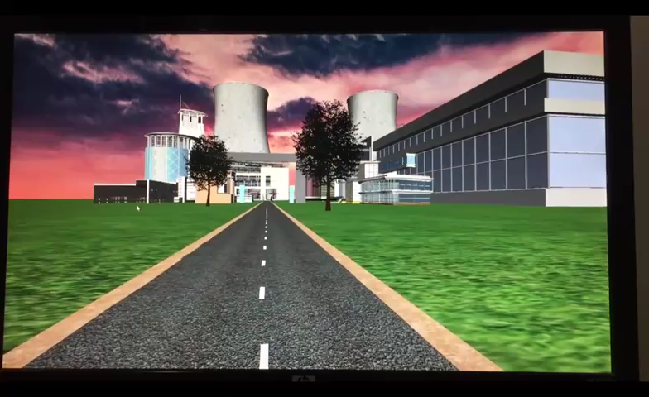
Product Demo

Slide 5
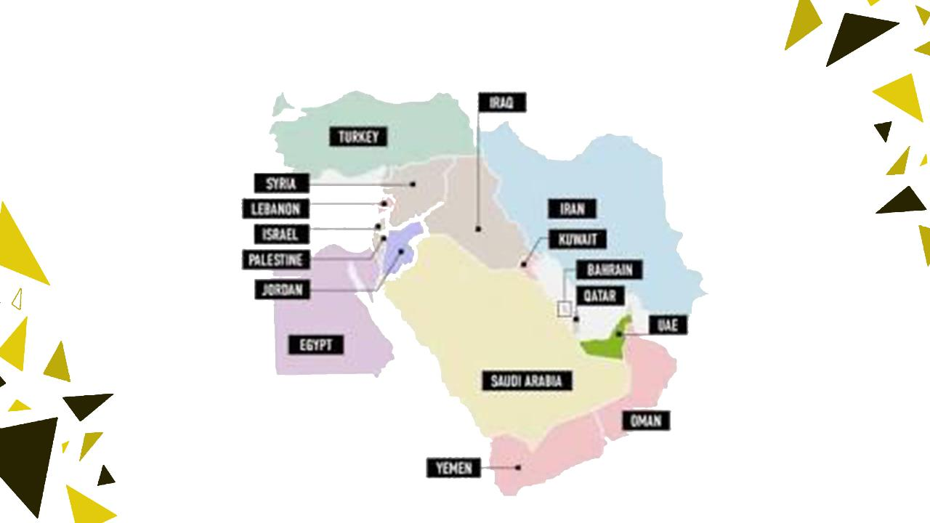
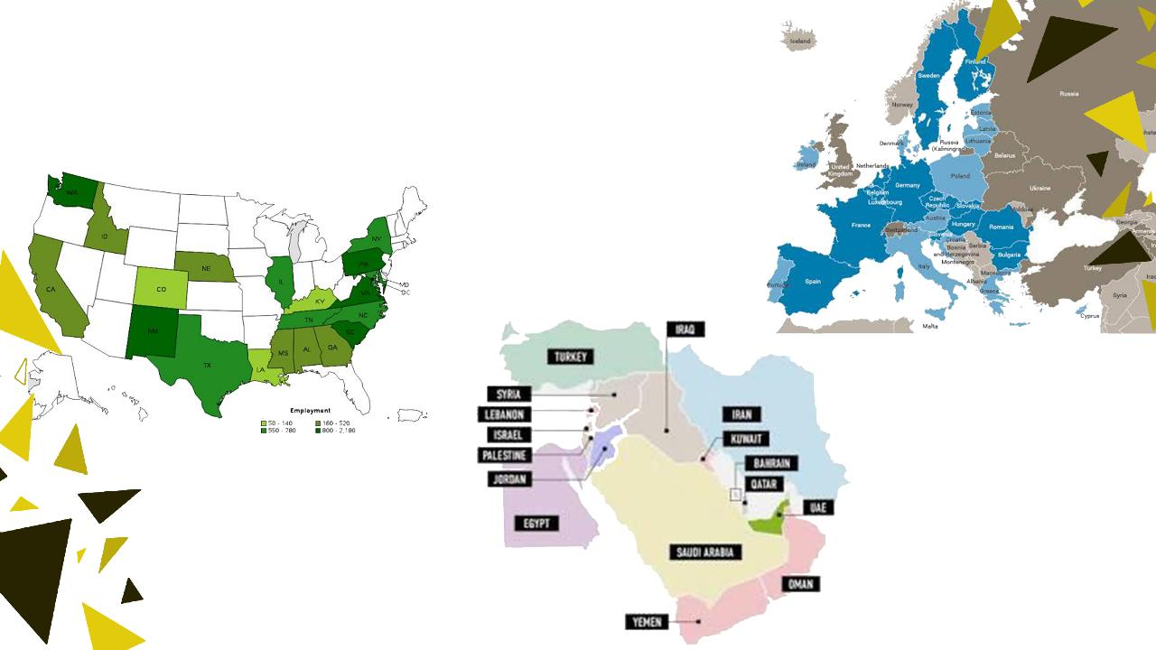
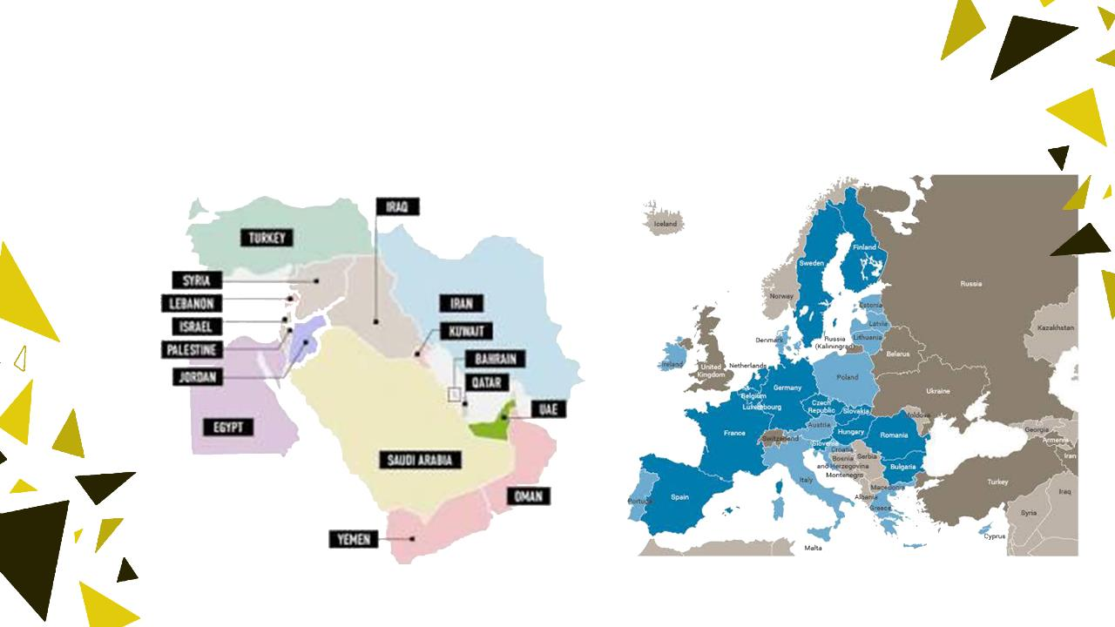
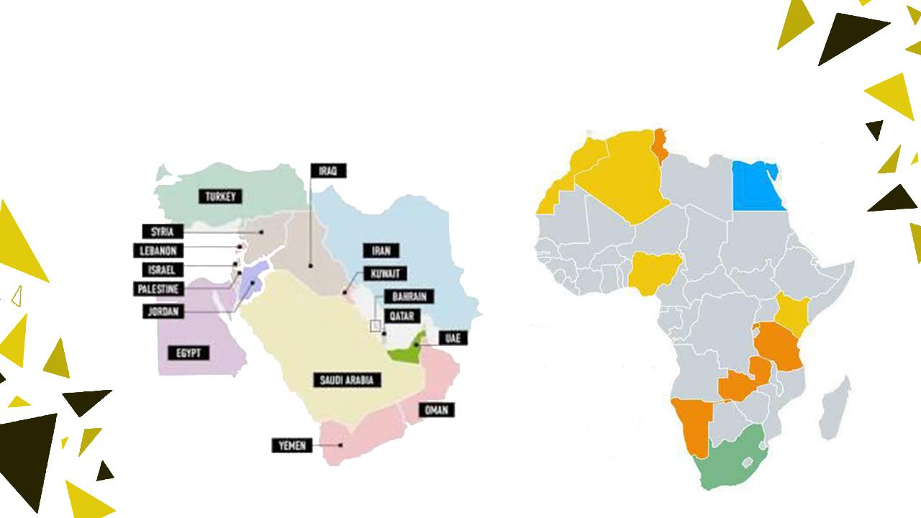
Market Size ≈ 14 Countries

Slide 6

Customer Segments
Universities
Schools
Research Centers
Nuclear Authorities

Slide 7
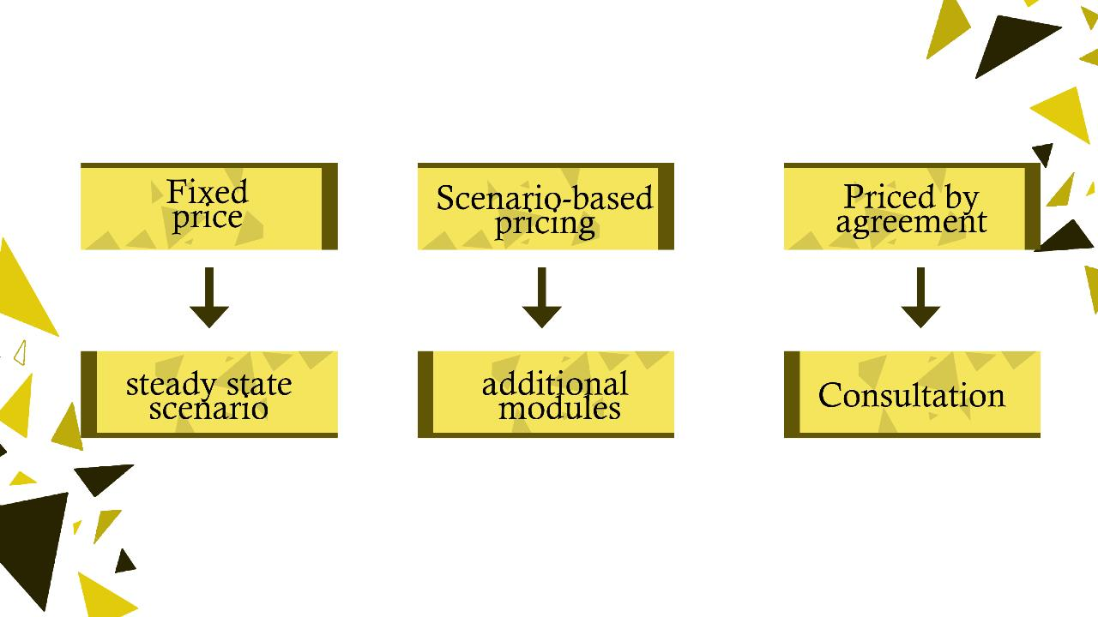
Pricing The Product

Slide 8
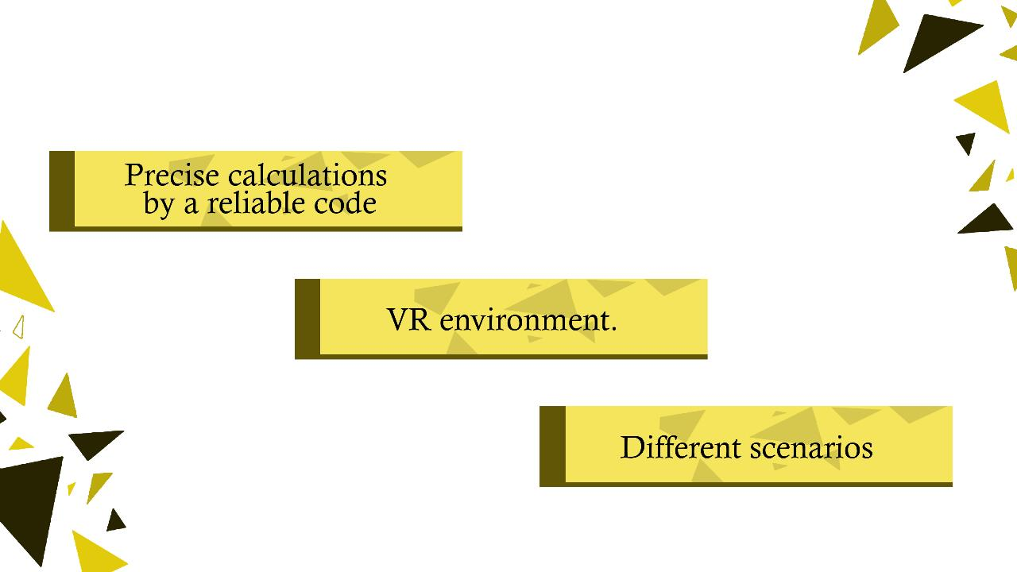
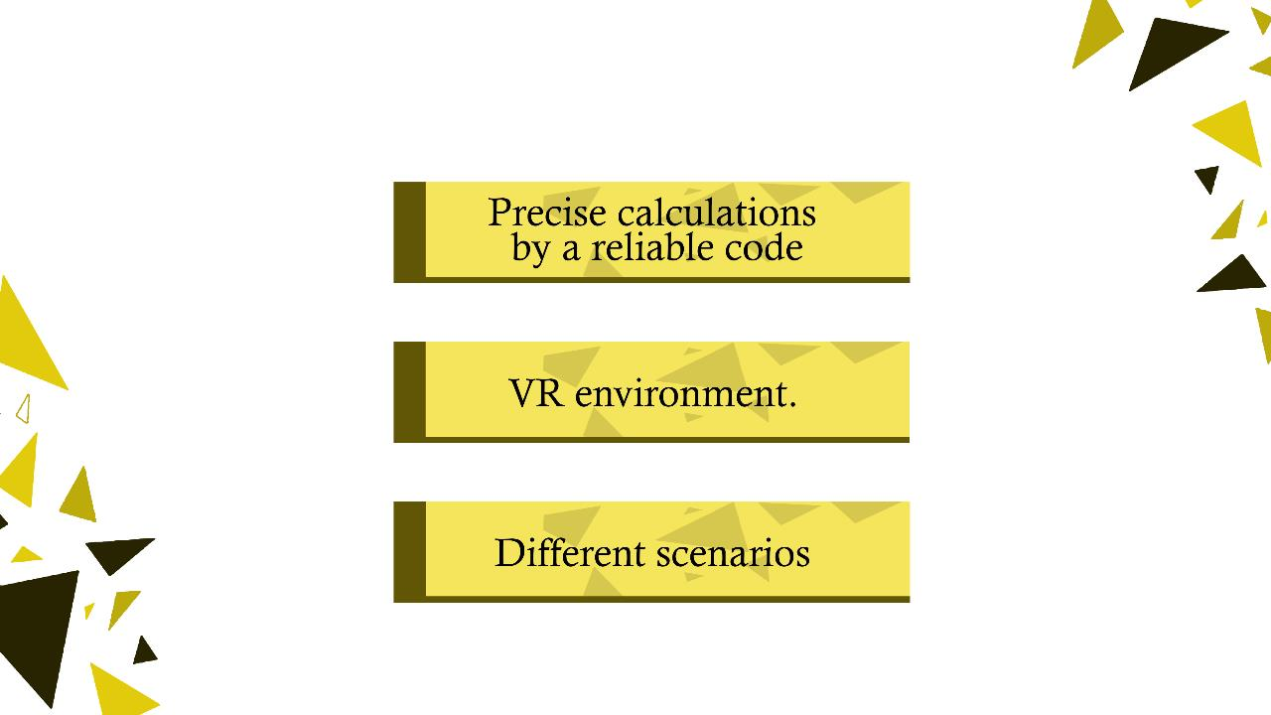
Features

Slide 9
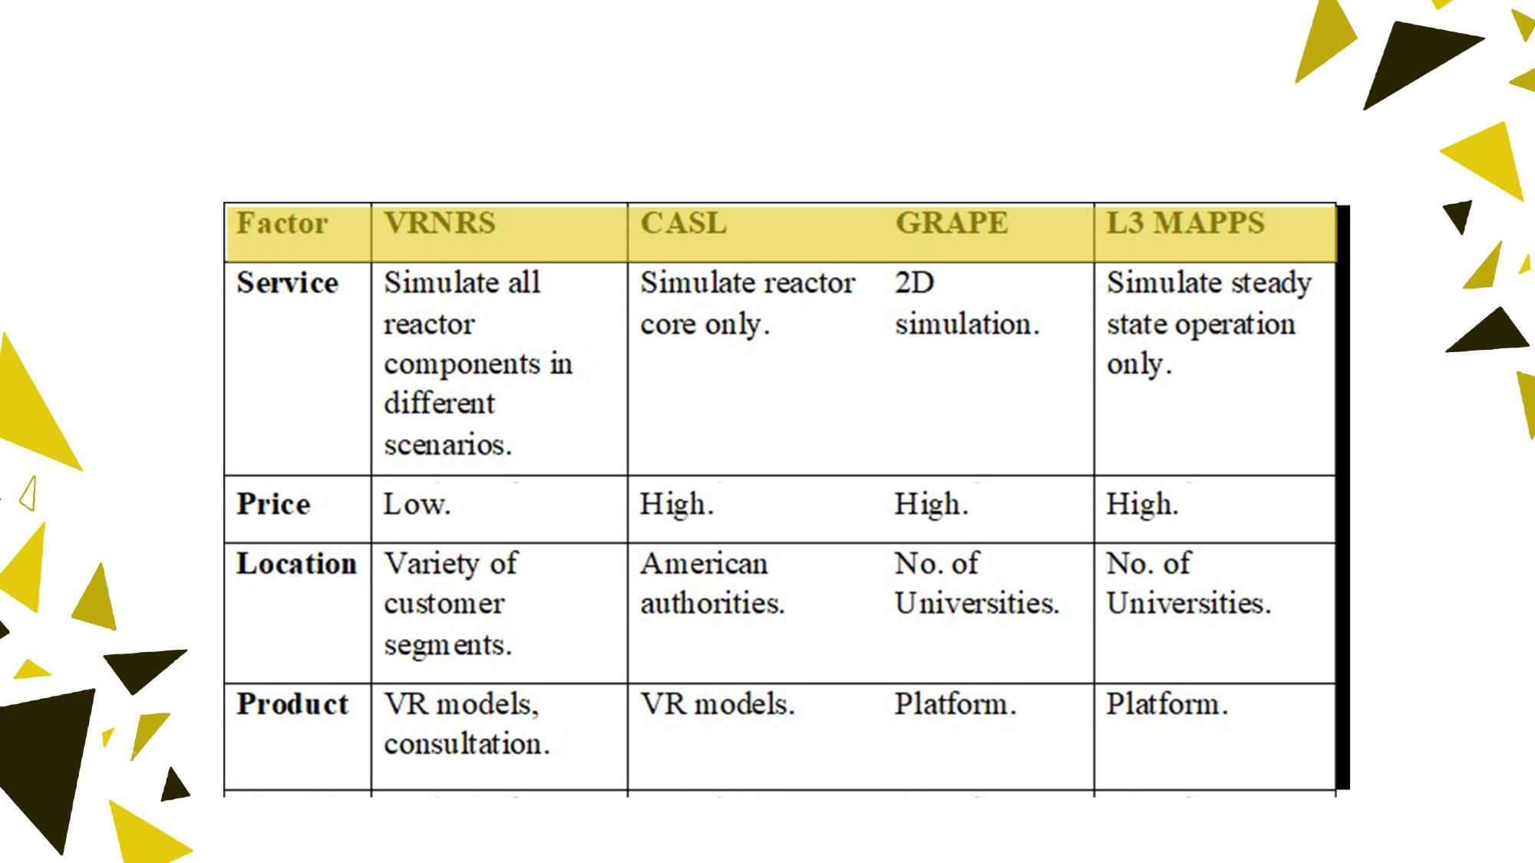

Competitors

Slide 10

MARKETING CHANNELS

Slide 11
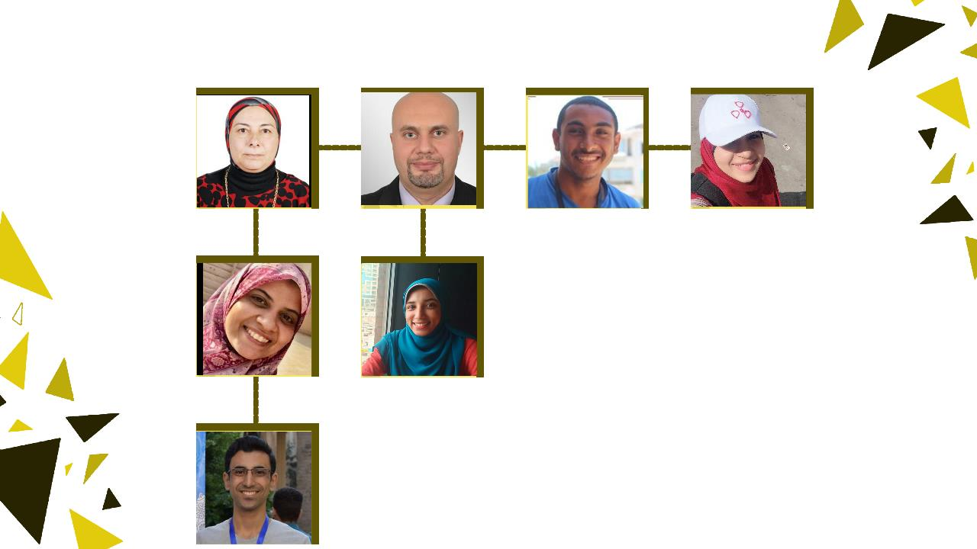
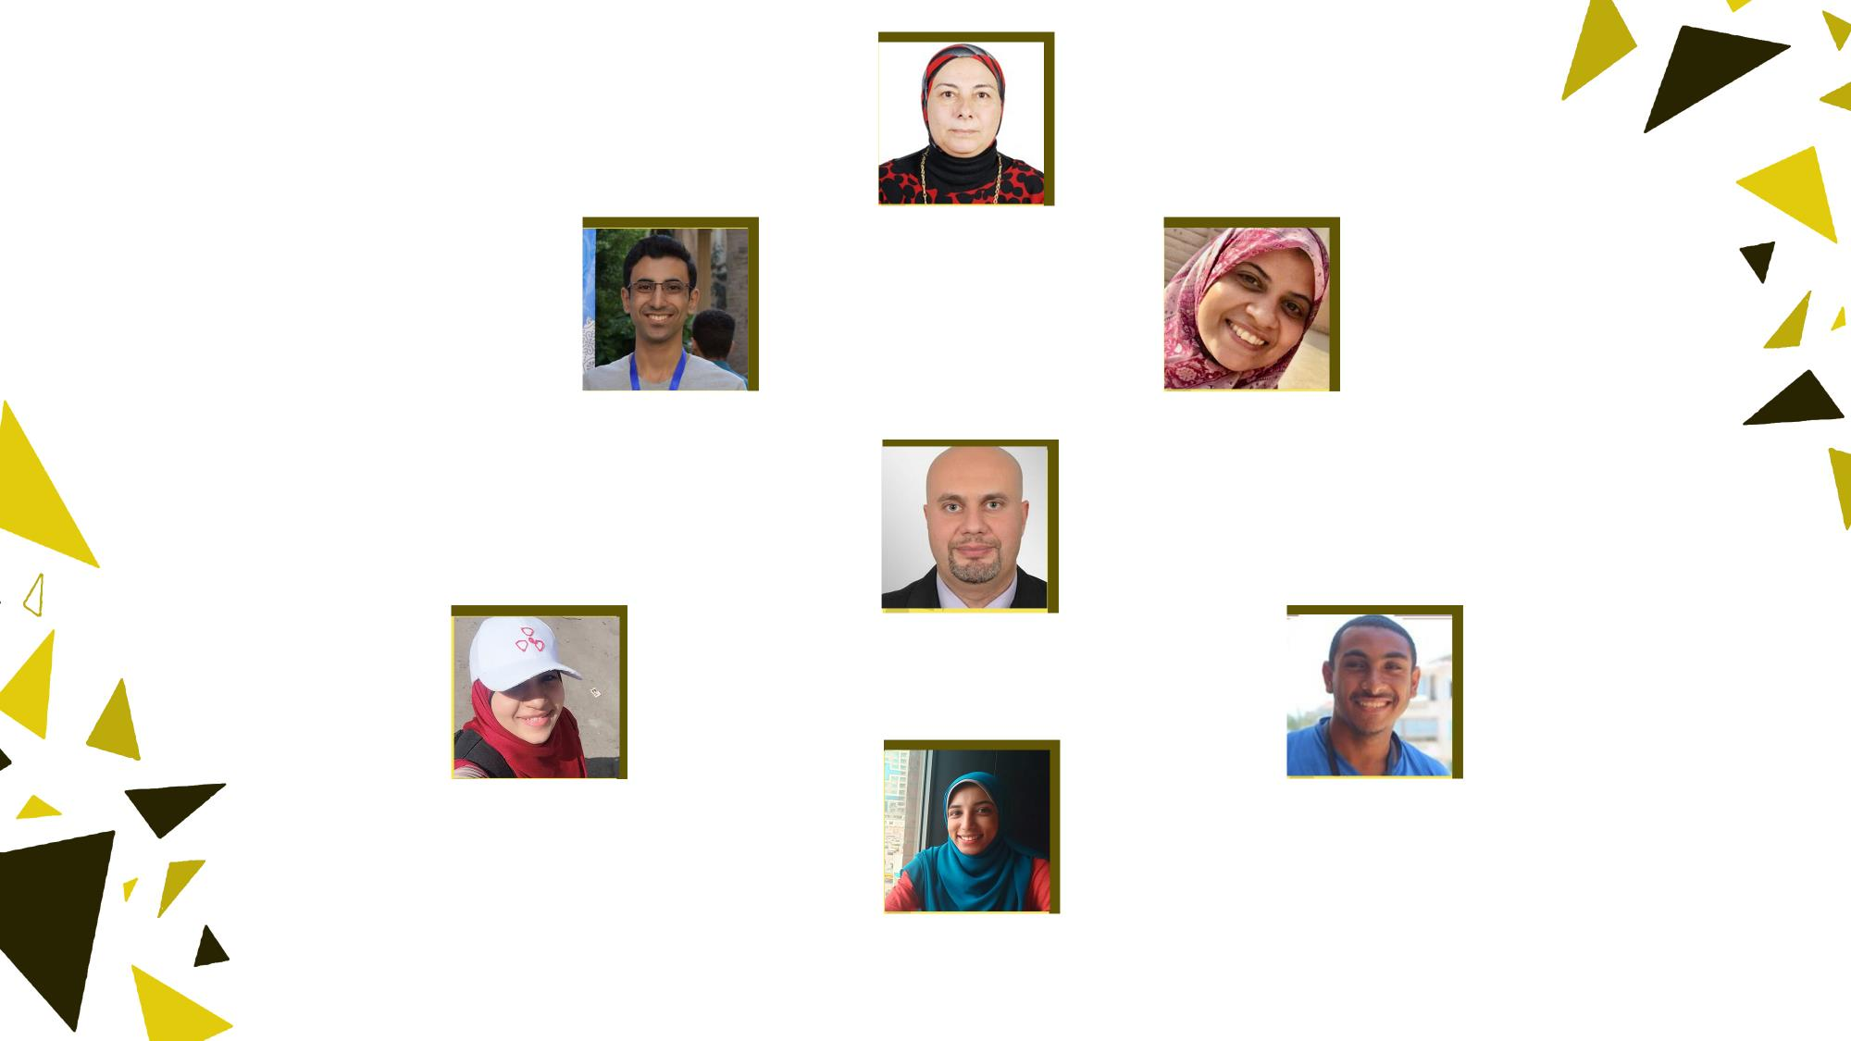
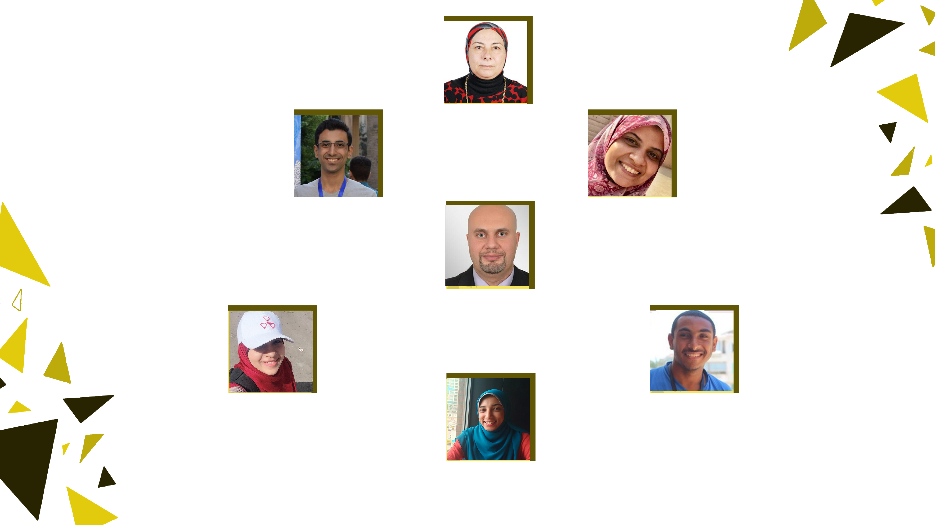
Team
Dr Hanaa
Nuclear team
PhD
39 Years
Eng Mohamed
Nuclear team
BSc 2020
Dr Ayah
Nuclear team
PhD
19 Years
Dr Hesham
programing team
PhD
21 Years
Eng Menna
Desginer
BSc 2020
Eng Abdelrhman
Financig & marketing
BSc 2016
Eng Walaa
Programing team
BSc 2018

Slide 12
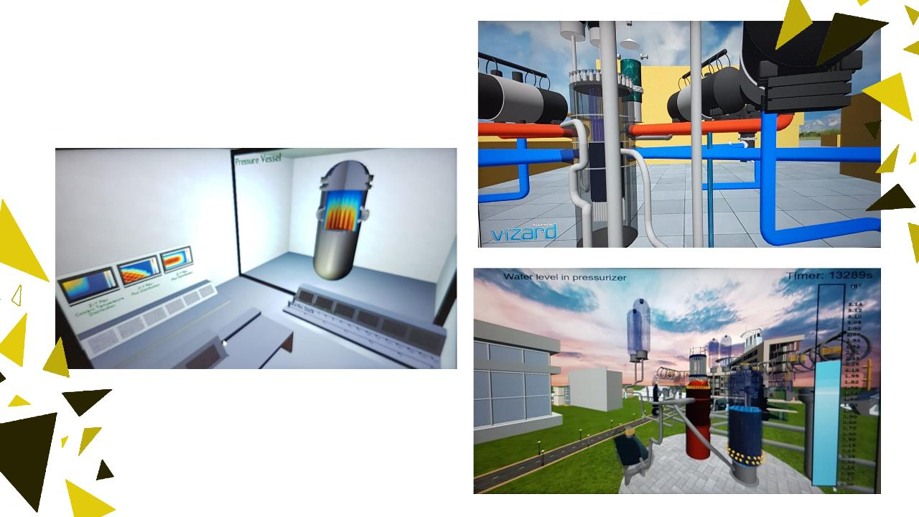
Prototypes

Slide 13
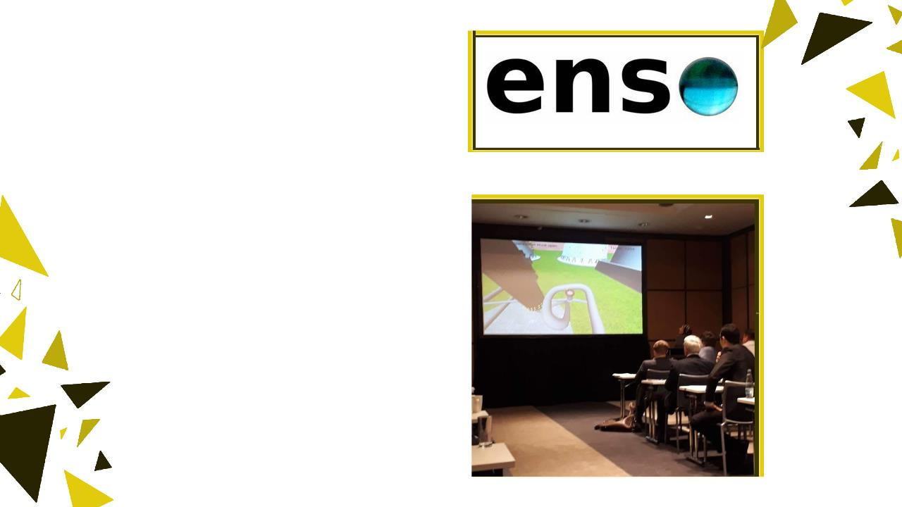
Potential
Partnership
Conference
Presentations

Slide 14
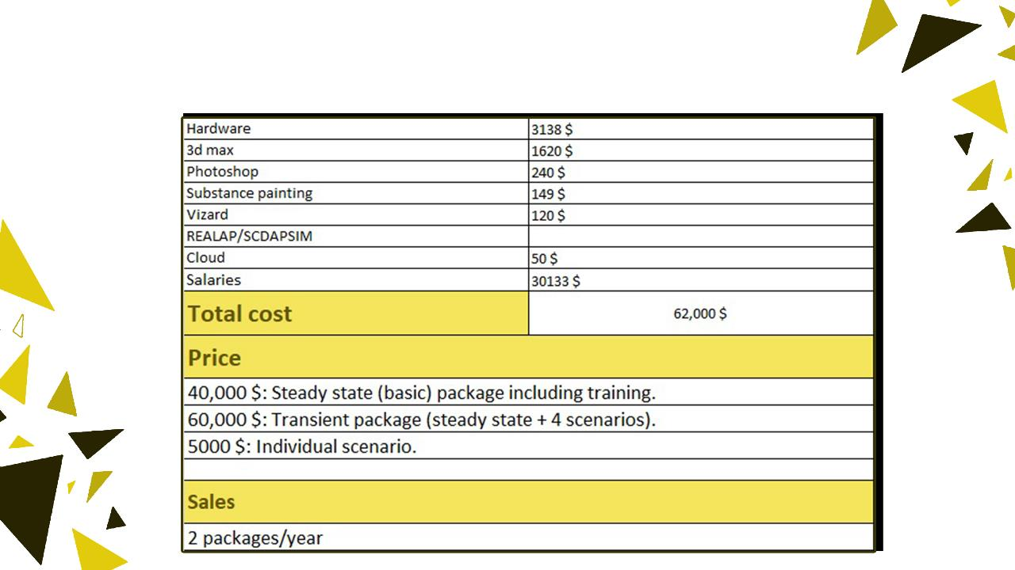
Finance

Slide 15
REINVENTING NUCLEAR EDUCATION

Slide 16
THANK YOU

